Slide 1
Code-Switching between Academia and Research Consultancy
©Code-Switch Consultants

Slide 2
Code-Switching:
The phenomenon in which speakers of more than one language switch between languages within the same conversation.
Code-Switch Consultants:
Helping researchers code-switch between academia and business since March 2020.
©Code-Switch Consultants

Slide 3
The Team
Hellen Parra-Flórez
Anna Brady
Dr Kat Kucaba
Code-Switch Director and
Research Consultancy Programme Manager
Project Management Consultant
Research Consultant
©Code-Switch Consultants

Slide 4
Who we are
University of Manchester Staff Start-Up
Est. March 2020
We equip PhD and postdoctoral researchers with in-demand industry skills through practical MBA-style consultancy projects.
Our mission is to provide researchers with practical experience to support their career progression inside or outside academia.
Access cases studies.
Attend one of our weekly information sessions.
Twitter: @CodeSwitch Cons
©Code-Switch Consultants

Slide 5
The Code-Switch Consultancy Method
©Code-Switch Consultants

Slide 6
The CSC Method: 4 Stages
©Code-Switch Consultants

Slide 7
The CSC Method: 4 Stages
1. Initiation
2. Delivery
Define the problem and approach
Analyse the need/challenge/opportunity
Plan and agree the what, how and when
Engage the client frequently
Negotiate and document what you will do
Conduct research in line with plan
Gather data
Proactively manage and monitor progress
Communicate with client throughout
Analyse and diagnose what the data show
3. Reporting
4. Evaluation
Deliver proposals
Confirm findings and define recommendations/solutions
Identify key messages to present to client
Produce client report and presentation
Measure the success of the assignment
What went well/what did no go well
Include multiple stakeholder perspectives
Communicate key lessons learned
©Code-Switch Consultants

Slide 8
Tailoring your Research Approach
©Code-Switch Consultants

Slide 9
Choice of Methods
Method | Key considerations
Literature review | Gives overview of the market, problem, or context Must include information on the search: key search terms, database, no. of records found, no. of records selected, selection criteria, type of records included
Survey | Can be done online, relatively short, many responses
Interviews | Depth of information, talking to professionals, potential clients, can be done online
Focus groups | Easy to conduct, depth of information, many points of view, can be done online
Case studies | Of competitors, other companies who do similar things
Statistical analysis | Often database is obtained from the client
©Code-Switch Consultants

Slide 10
Report Writing: Best Practice
Follow academic standards
Use plain English
Clearly summarise content and recommendations
Every section of the report must be justified
Report sections must follow logically from one another
Ensure all agreed objectives, research questions and outputs have been addressed
The report be of a professional level, both in terms of content and formatting
©Code-Switch Consultants

Slide 11
Project Management Toolkit for Consultancy
©Code-Switch Consultants

Slide 12
Project Management: Set Yourself up for Success
Understand your stakeholders and manage them accordingly
They can make, and break, any project!
Be clear about why you are doing every task
What is it producing?
Think about risks
It’s a risky business and they will come to bite you!
©Code-Switch Consultants

Slide 13
Stakeholder Management
Stakeholder:
individual, group or organisation
anyone who can affect, be affected by, or perceive itself to be affected by an initiative
may be indifferent, support or block the initiative
Stakeholder Management:
Identify stakeholders – users, suppliers, decision-makers
Analyse stakeholders – what is their attitude, e.g. supporter/blocker? – what is their specific interest in and influence over your assignment?
Plan and deliver effective comms and engagement to achieve and maintain buy-in, a critical success factor
©Code-Switch Consultants

Slide 14
Product-Based Planning
Product-orientated, rather than task-orientated
Identifies products and sub-products
Logical
Comprehensive
Reduces wasteful activity
Helps define the project scope helps to avoid ‘scope creep’
Reduces risk of creating products which are not fit-for-purpose
Motorcycle
Engine
Frame
Suspension
Transmission
Handlebars
Wheels
©Code-Switch Consultants

Slide 15
Product-Based Planning
Motorcycle
The exam question:
What product is this task contributing to?
If we cannot answer this question,
how can we know we are doing the right tasks?
Engine
Frame
Suspension
Transmission
Handlebars
Wheels
©Code-Switch Consultants

Slide 16
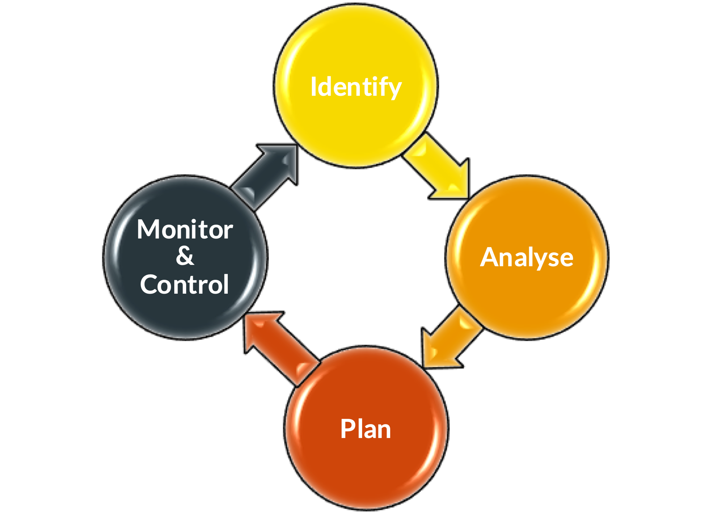
Risk Management
Risk: An uncertain event or set of events which, if they occur, will affect the achievement of objectives
Projects/consultancy are ‘risky’ undertakings:
Introducing new information/solutions – not BAU
Working in new ways with new people
Costly
Outcomes not guaranteed
Risk Management – essential skill and critical success factor in projects and consultancy
©Code-Switch Consultants

Slide 17
Discussion and Q&A
©Code-Switch Consultants

